Slide 1
Notes:
A lot has changed over the last 30 years. Have a look at the images on screen of different items and we will ask you to vote for the one that you think is from 30 years ago. You vote through one of the poses shown on the screen. Give an example
If you are not comfortable or not able to get active, you can vote with choosing 1, 2 or 3 instead.

Slide 2
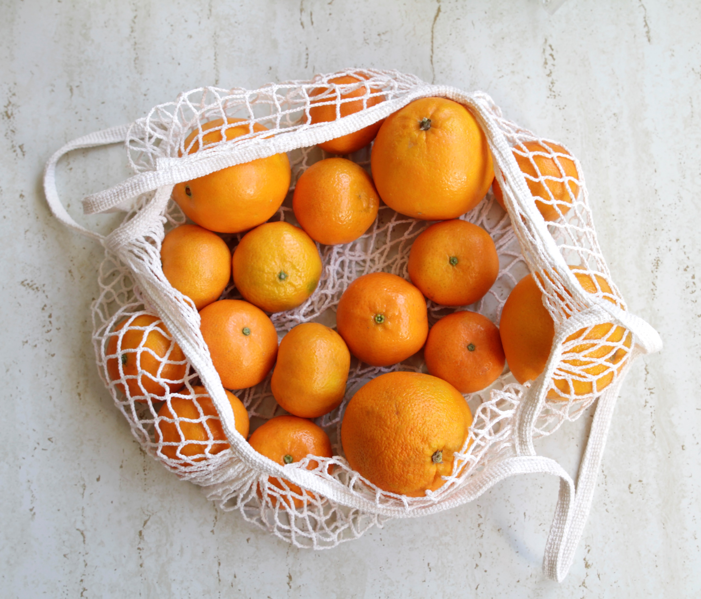
Notes:
Can Oranges be made into clothes?

Slide 3
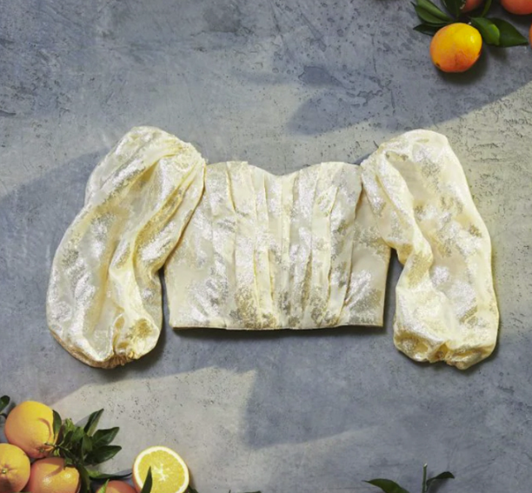
Notes:
True! From the waste of the juice industry, an Italian designer worked out a way to extract the fibre from the orange skin to make a silk-like fabric!

Slide 4
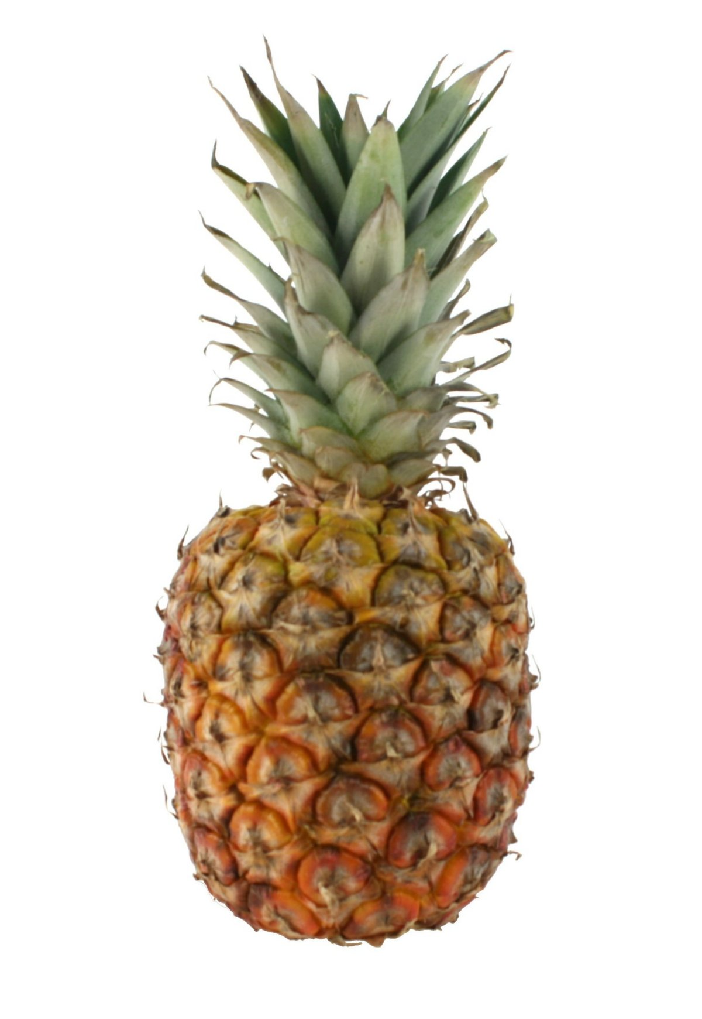
Notes:
Can Pineapples be made into clothes?

Slide 5
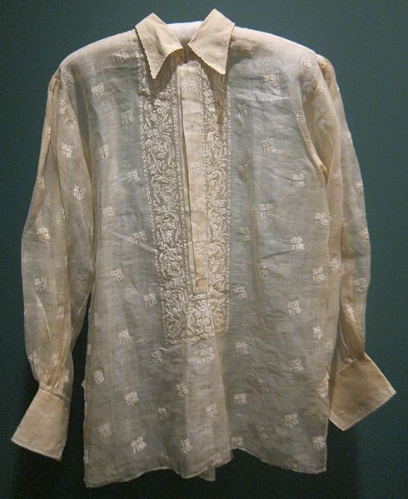
Notes:
Pineapply silk used to be considered the queen of Philippine fabrics and is considered the fabric of choice of the Philippine elite.
The fibres are scraped from the leaves, washed and dried and then waxed and woven. The fibre is turned into a silky fabric and a course fabric for rugs.
It takes a lot of time to create by hand so became less popular when mass produced cotton was introduced. Maybe we would value our clothes more if we had to create the fabric ourselves?
A fabric called Pinatex is also made from pineapple leaves and is an alternative to leather.

Slide 6
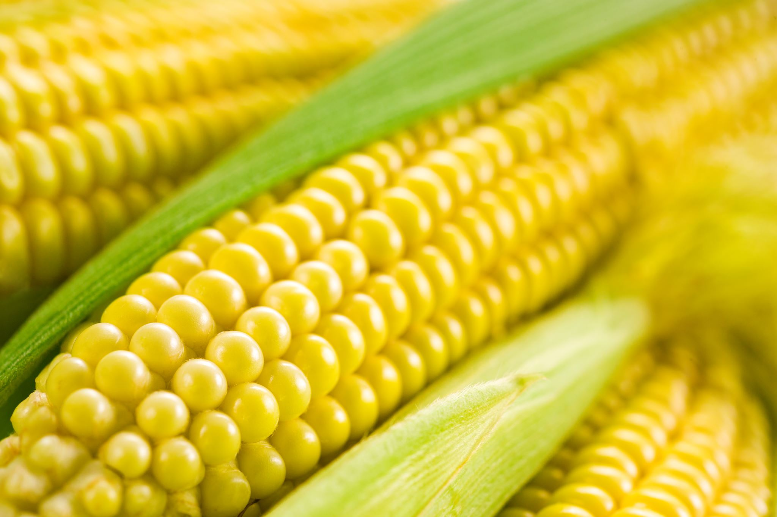
Notes:
Can sweetcorn

Slide 7
Notes:
We don’t believe it currently is but a budding young eco entrepreneur from an eco-committee in south Wales has recently designed a concept called ‘Cob Clothing’ – watch this space!

Slide 8
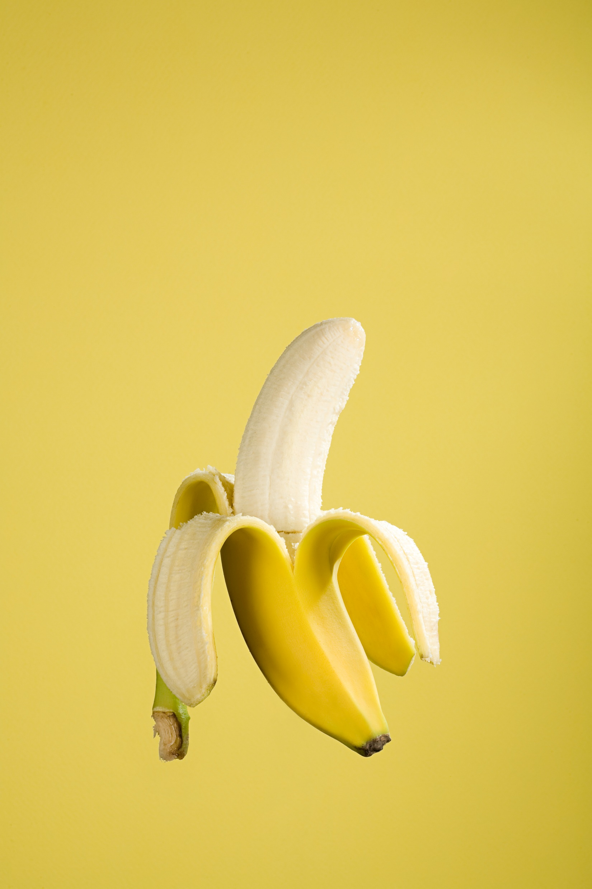
Notes:
What about bananas?

Slide 9
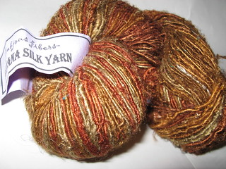
Notes:
Similar to pineapple leaves, the skin from the banana can be used to create 2 types of fabric – the inside soft bit makes a silk-like fabric that is very expensive but luxurious. The outside makes a thicker fabric that can be used for ropes or doormats and is cheaper to produce.
All of it uses a waste product that would be left to rot otherwise!
India is the World’s largest producer of banana fibre.

Slide 10
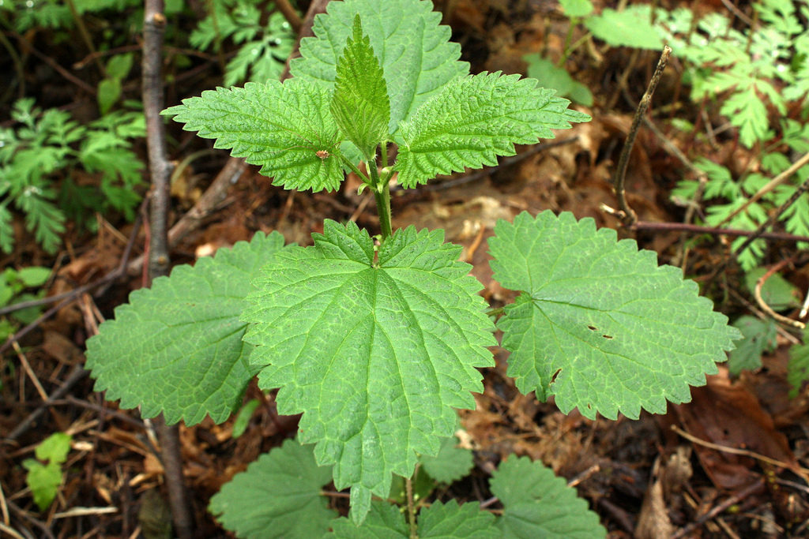
Notes:
Nettles?
Surely this one is made up – they’d be really stingy!

Slide 11
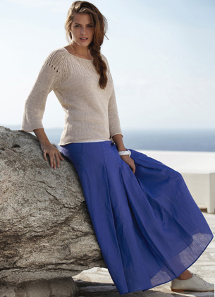
Notes:
History of nettle tissue
Ramie, or Boemeria, is a genus of plants in the nettle family. Spinning culture, known to people over six thousand years, originating mainly from the tropical and subtropical regions of East Asia. In order to obtain fibers, usually in the tropics, white ramie or Chinese nettle and green ramie, or Indian nettle are cultivated. Man has long been using nettle fiber. During excavations near Kiev, the burial sites of Scythians dated to the beginning of the III century, nettle fibers were found in the tissues.
Nettle tissue properties
Firstly, the fiber has a shine that is not lost, unlike silk, under the influence of sunlight. Secondly, the material is very lightweight, which protects from fatigue and makes clothes extremely practical. And of course, comfortable sensations are provided with 100% naturalness, because the material “breathes”.

