Slide 1
Notes:
A lot has changed over the last 30 years. Have a look at the images on screen of different items and we will ask you to vote for the one that you think is from 30 years ago. You vote through one of the poses shown on the screen. Give an example
If you are not comfortable or not able to get active, you can vote with choosing 1, 2 or 3 instead.

Slide 3
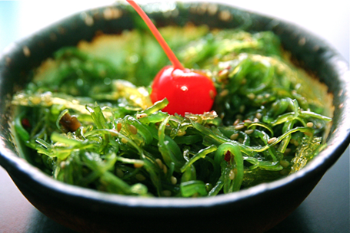
Notes:
Ounce for ounce, seaweed contains more minerals and vitamins than any other food growing on land. Some of the nutrients which seaweed is high in includes iron, calcium and vitamin c, just to name a few.

Slide 5
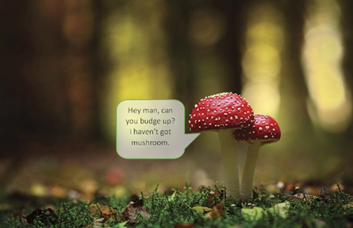
Notes:
Researchers have found that fungi use electrical impulses to communicate with each other in their very own language. 50 words is more than the average house cat knows! Who knew mushrooms were such chatterboxes?

Slide 7
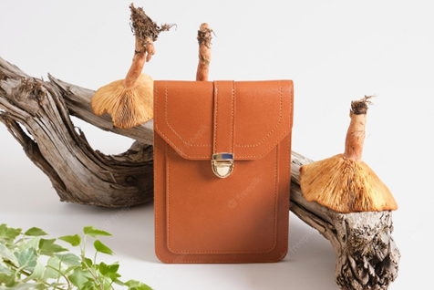
Notes:
The underground part of the fungi, called the mycelium, can be used the create leather. The mushroom leather, unlike other fake leathers, is entirely natural and biodegradable, which means it won't damage the planet.
Although should also mention, seaweed can also be used to create other types of fabric which are more sustainable than traditional fabrics like cotton or polyesters.

Slide 9
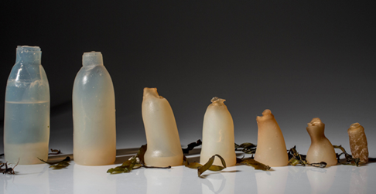
Notes:
Yep, seaweed could be used to completely replace the plastics we currently use which we make from crude oil. It breaks down far quicker than traditional plastics, reducing litter issues. Not to mention it bio-degrades entirely, instead of breaking down into micro-plastics which make their way into the food chain and cause issues for many animals.

Slide 11
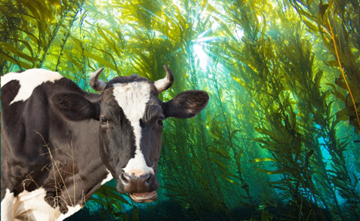
Notes:
When added to cattle feed, it has been proven that methane levels in bovine gasses can be reduced by up to 80%! It is also more sustainable to grow than traditional animal feed as it requires no additional freshwater, fertilizer or energy input to help it grow.

Slide 13
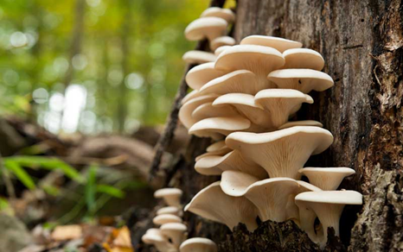
Notes:
Scientists have discovered that Oyster mushrooms can gobble up petroleum and break it down more effectively than man-made solutions, but that’s not all, scientists have also found species of mushrooms that can break down plastics and clean up nuclear waste.

Slide 15
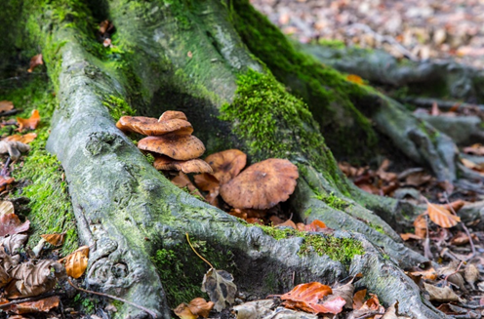
Notes:
Without fungi, we wouldn’t have trees and forests. The fungi and the trees have a symbiotic relationship, meaning they both help each other to survive. The trees absorb carbon which they swap with the fungi living on their roots, for important nutrients from the soil. So, when we think about how important trees are to save our climate, we must also remember their best friend, the fungi.

Slide 17
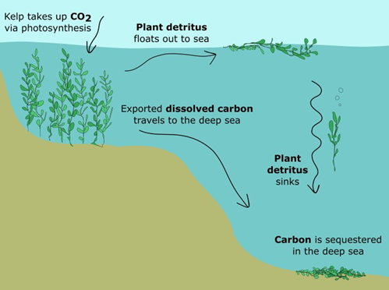
Notes:
Like trees, seaweed absorbs CO2 as it grows and releases oxygen. So, what’s so great about seaweed? Well, it seems seaweed can absorb carbon about 30-60 times faster than a land-based plant.

Slide 19
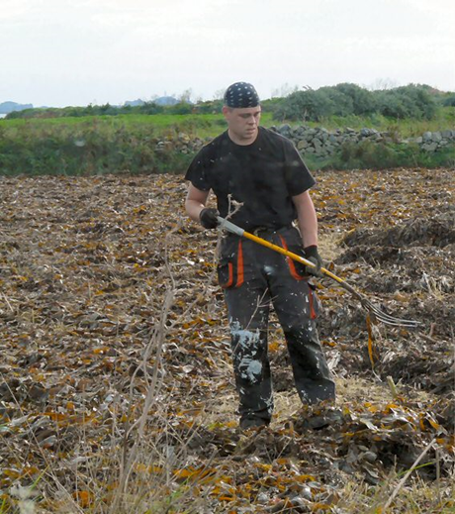
Notes:
We already know that seaweed contains plenty of minerals and vitamins, but what else makes it such a brilliant fertilizer? It can be added directly to soil without decomposing first, it is non-toxic and can be easily absorbed by plants. It also doesn’t cause problems for ocean ecosystems if it is washed off the land and into rivers and the sea, unlike chemical based nitrogen fertilisers that are used widely.

Slide 21
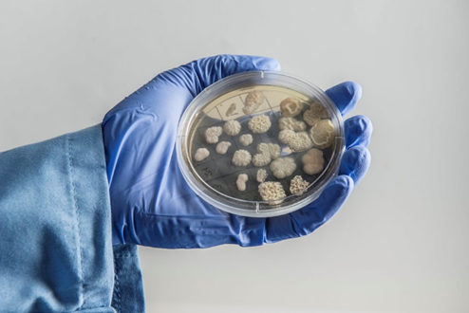
Notes:
Fungi. There is still lots of work to do to make this happen, but scientists have found a way to create a fuel which would run an everyday, petrol or diesel car without having to adapt it in anyway. Could this be the next answer to greener travel?

