Slide 1
Notes:
A lot has changed over the last 30 years. Have a look at the images on screen of different items and we will ask you to vote for the one that you think is from 30 years ago. You vote through one of the poses shown on the screen. Give an example
If you are not comfortable or not able to get active, you can vote with choosing 1, 2 or 3 instead.

Slide 2
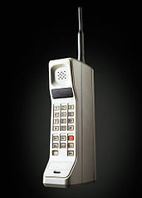
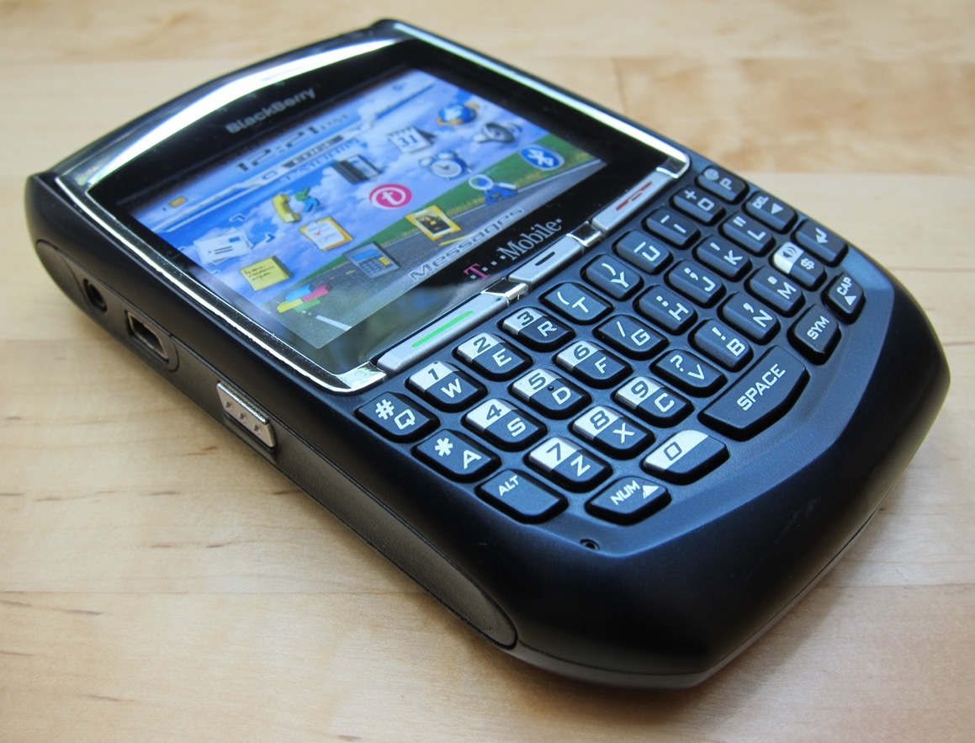
Notes:
Vote for which mobile phone is from the 1990s.
Answer is the middle one. The first is a Blackberry from 2000s and the other is the 1980s.

Slide 3
Notes:
The first mobile phone cost $4000 in 1983
These days more than 4 billion people own mobile phones. But only 3.5 billion use a toothbrush.
Do you know that the present mobile phones have more computing power than the computers used for the Apollo 11 to land on the moon.

Slide 4
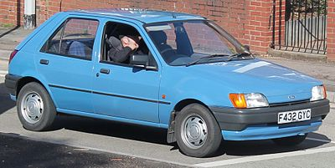
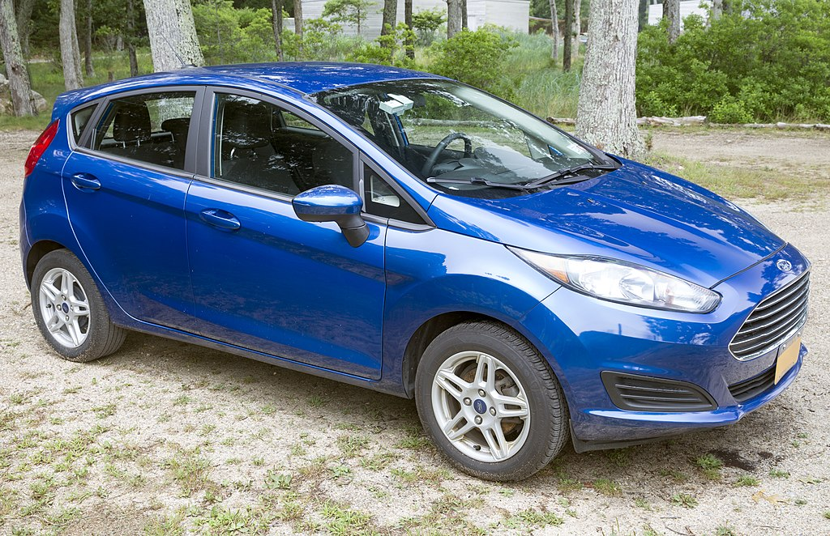
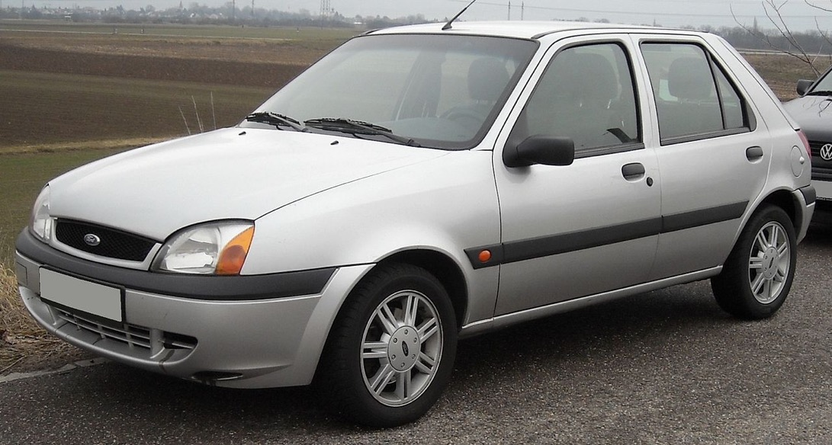
+
Notes:
These are all Ford Fiesta models! 1990s, 2000s, present day

Slide 5
+
Notes:
There are over 40 million vehicles in the UK, a number that keeps on growing. The most popular vehicle is still a Ford Fiesta!
Incredibly the average vehicle is parked 96% of the time (that means it is driven for less than an hour a day). Good for the planet maybe but why do we have so many??
There are now nearly 1 million electric or hybrid vehicles on our roads and the numbers are increasing steadily. What will 2052 look like?

Slide 6
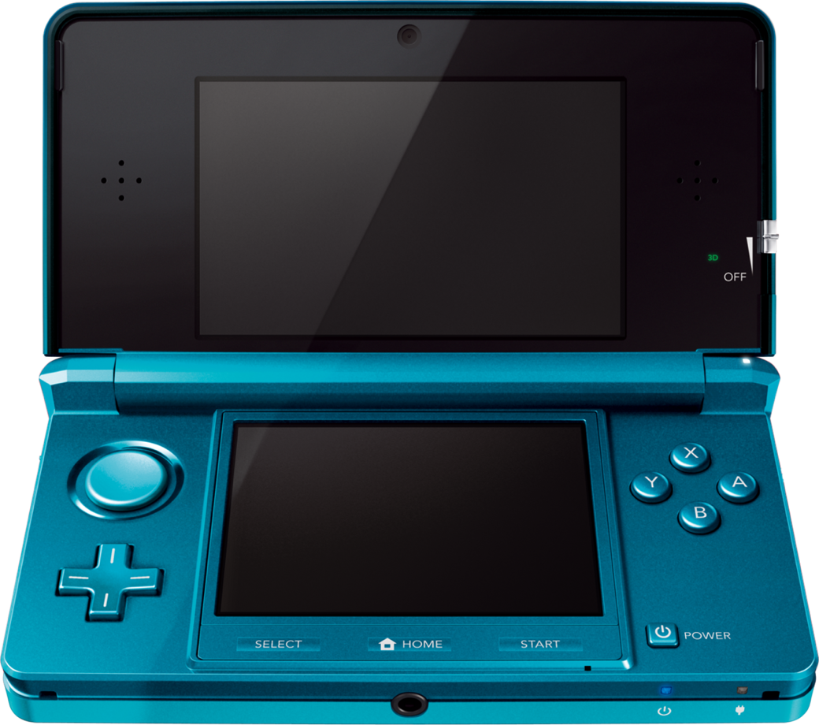
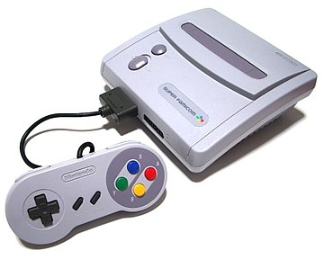
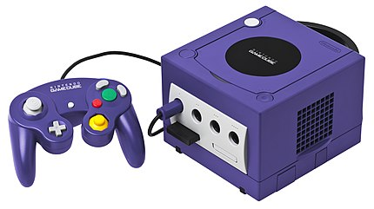
Notes:
These are all Nintendo consoles! Super Nintendo came out in early 1990s, Game Cube 2000 and then Nintendo DS closer to 2010

Slide 7
Notes:
These are all Nintendo consoles! Super Nintendo came out in early 1990s, Game Cube 2000 and then Nintendo DS closer to 2010

Slide 8
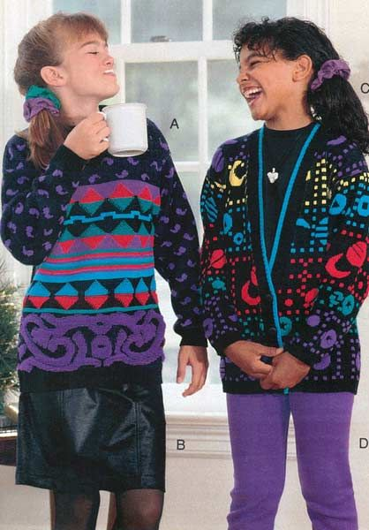
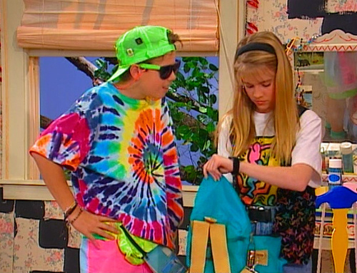

Slide 9
Notes:
Fashion has changed a lot over the decades but these days, the trend is changing so rapidly that there isn’t a ‘way’ to dress in the way that there was in the 90s or earlier. Early 1990s saw a big rise in the popularity of shell suits as well as platform shoes and doc martin boots. Fashion tended to stay around longer than it does now. You could probably wear any of these outfits today and all would be cool; we create our own style. Maybe this is a great thing for the future or maybe it is something that we don’t want so that we can move away from the huge amount of clothing that we are using and throwing away?

Slide 10
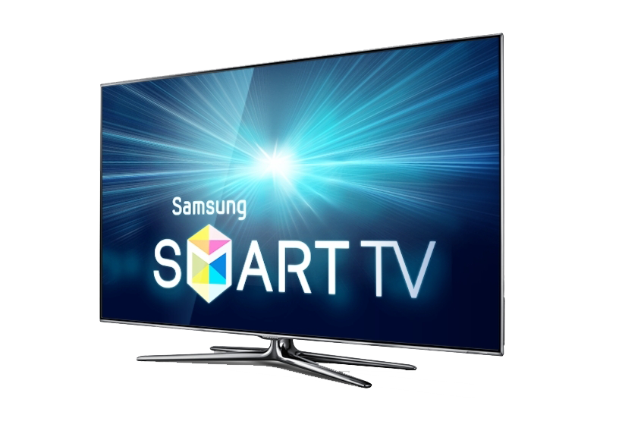
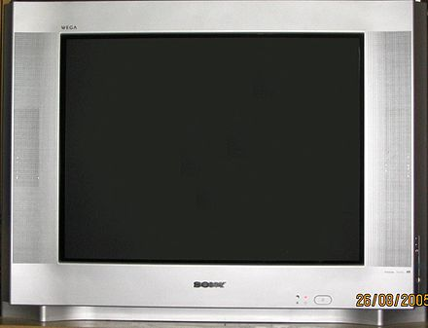
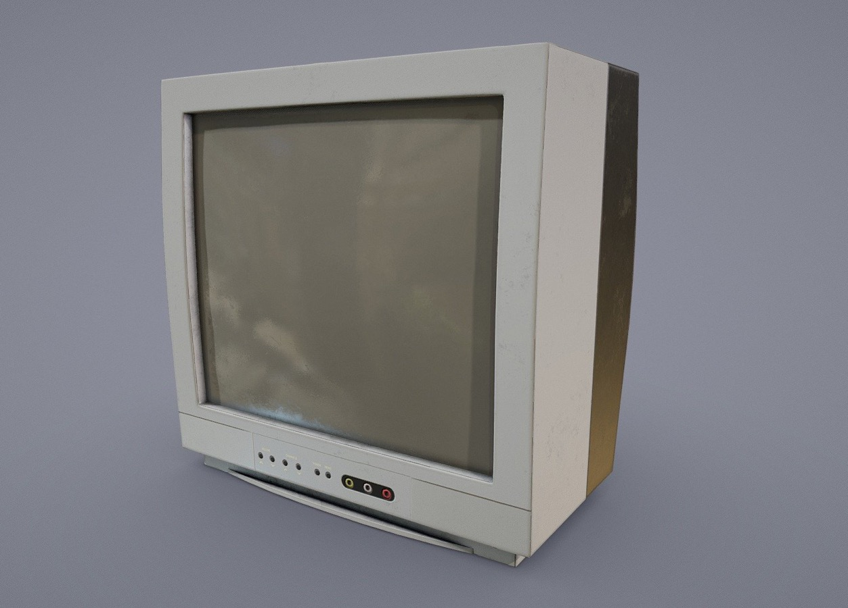
Notes:
2005, 1990, present day.

Slide 11
Notes:
2005, 1990, present day.
Technology has changed a lot with the invention of the cathode ray and LED technology to enable flat screen and HD pictures.
Maybe in the future we will not have a TV at all but will watch via a VR headset?

